Slide 1
Chapter 12: Query Processing

Slide 2
Chapter 12: Query Processing
Overview
Measures of Query Cost
Selection Operation
Sorting
Join Operation
Other Operations
Evaluation of Expressions

Slide 3
Basic Steps in Query Processing
1. Parsing and translation
2. Optimization
3. Evaluation

Slide 4
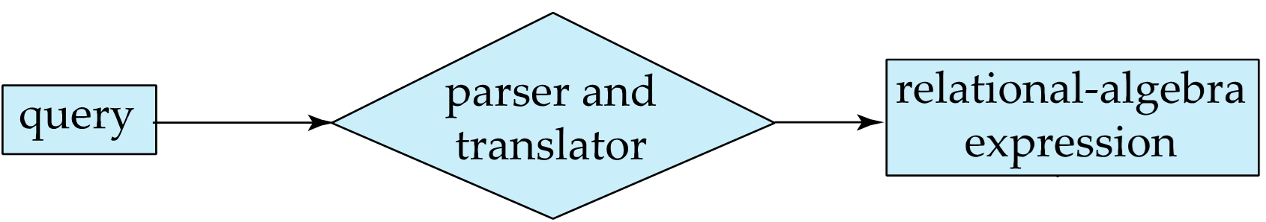
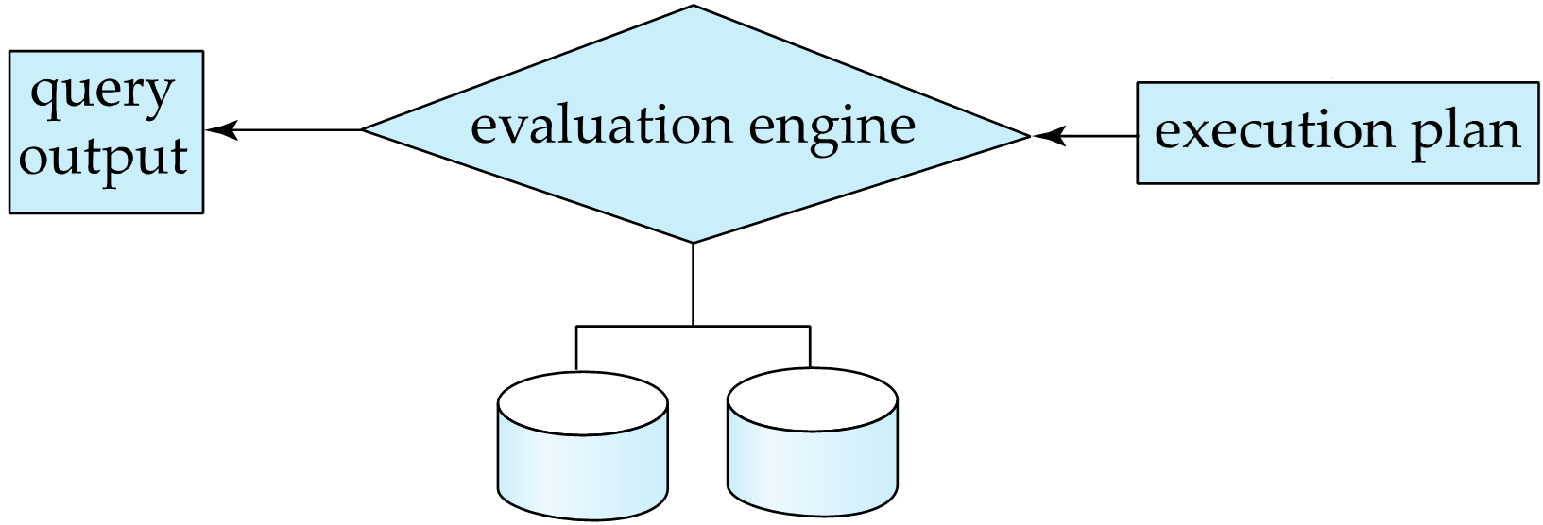
Basic Steps in Query Processing (Cont.)
Parsing and translation
translate the query into its internal form. This is then translated into relational algebra.
Parser checks syntax, verifies relations
Evaluation
The query-execution engine takes a query-evaluation plan, executes that plan, and returns the answers to the query.
Data dictionary

Slide 5
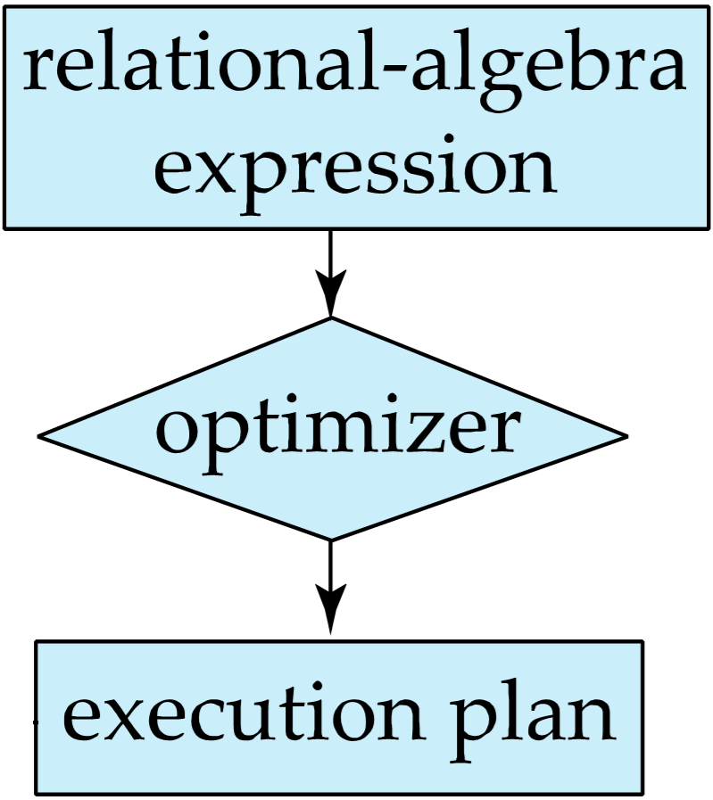
Basic Steps in Query Processing : Optimization
A relational algebra expression may have many equivalent expressions
E.g., σ_{salary<75000}(∏_{salary}(instructor)) ∏_{salary}(σ_{salary<75000}(instructor))
Each relational algebra operation can be evaluated using one of several different algorithms
Correspondingly, a relational-algebra expression can be evaluated in many ways.

Slide 6
Basic Steps in Query Processing : Optimization
Annotated expression specifying detailed evaluation strategy is called an evaluation-plan.
E.g., can use an index on salary to find instructors with salary < 75000,
or can perform complete relation scan and discard instructors with salary ≥ 75000

Slide 7
Basic Steps: Optimization (Cont.)
Query Optimization: Amongst all equivalent evaluation plans choose the one with lowest cost.
Cost is estimated using statistical information from the database catalog
e.g. number of tuples in each relation, size of tuples, etc.
In this chapter we study
How to measure query costs
Algorithms for evaluating relational algebra operations
How to combine algorithms for individual operations in order to evaluate a complete expression
In Chapter 14
We study how to optimize queries, that is, how to find an evaluation plan with lowest estimated cost

Slide 8
Example
Schema
branch (branch_name, branch_city, assets)
account (account_number, branch_name, balance)
depositor (customer_name, account_number)
Query: Find the names of all customers with an account at a Brooklyn branch whose account balance is less than $1000.

Slide 9
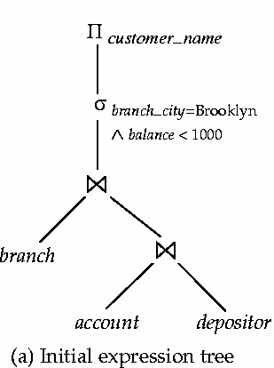
Example（语法分析与翻译）
SQL:
SELECT customer_name FROM account, branch, depositor WHERE branch_city = “Brooklyn” and balance < 1000 and account.customer_name=depositor.customer_name and branch.branch_name = account.branch_name
Π_{customer_name}((σbranch_city = “Brooklyn” ∧ balance < 1000 (branch (account depositor)))

Slide 10
Example（查询优化）
Query: Find the names of all customers with an account at a Brooklyn branch whose account balance is less than $1000. Π_{customer_name}((σbranch_city = “Brooklyn” ∧ balance < 1000 (branch (account depositor)))
优化策略1： branch的记录数不会太多，根据自然连接运算的结合律: Π_{customer_name}((σbranch_city = “Brooklyn” ∧ balance < 1000 (branch account)) depositor)
优化策略2： 及早进行“选择σ”操作，可减少中间结果 σ_{branch_city = “Brooklyn”} (branch) σ _{balance < 1000} (account)

Slide 11
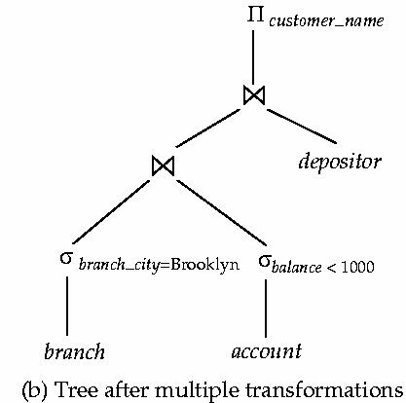
Example（优化结果）
Π_{customer_name}( (
σ_{branch_city = “Brooklyn”} (branch) σ _{balance < 1000} (account) ) depositor)

Slide 12
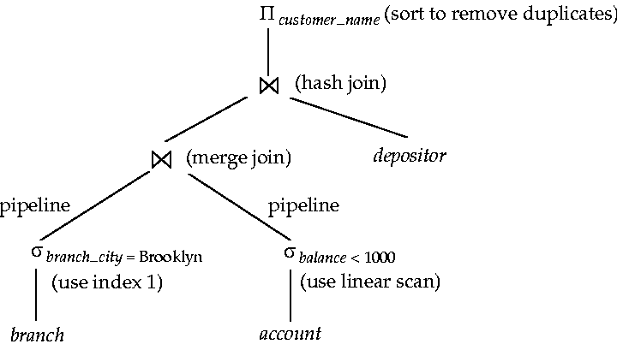
Example（执行计划）
Query: Find the names of all customers with an account at a Brooklyn branch whose account balance is less than $1000.

Slide 13
Measures of Query Cost
Cost is generally measured as total elapsed time for answering query
Many factors contribute to time cost
disk accesses, CPU, or even network communication
Typically disk access is the predominant cost, and is also relatively easy to estimate. Measured by taking into account
Number of seeks * average-seek-cost
Number of blocks read * average-block-read-cost
Number of blocks written * average-block-write-cost
Cost to write a block is greater than cost to read a block
data is read back after being written to ensure that the write was successful

Slide 14
查询代价的测量（预备知识）
数据在磁盘中 （I/O时间，或称为block Accesses）
磁盘→内存（读）
内存→磁盘（写）
寻道时间
数据在内存中（CPU时间）
CPU
CPU时间
内存
I/O时间
忽略
磁盘

Slide 15
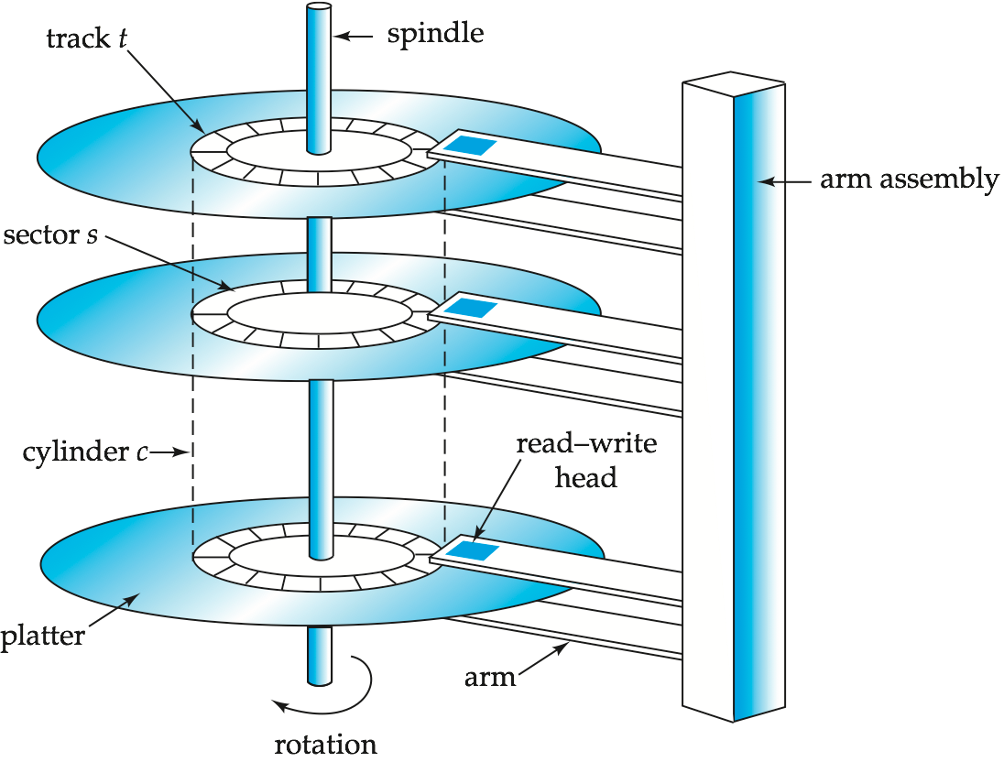
Measures of Query Cost (Cont.)
For simplicity we just use the number of block transfers from disk and the number of seeks as the cost measures
t_{T} – time to transfer one block
t_{S} – time for one seek
Cost for b block transfers plus S seeks b * t_{T} + S * t_{S}
取决于系统性能，常量

Slide 16
Measures of Query Cost (Cont.)
Several algorithms can reduce disk I/O by using extra buffer space
Amount of real memory available to buffer depends on other concurrent queries and OS processes, known only during execution
We often use worst case estimates, assuming only the minimum amount of memory needed for the operation is available
Required data may be buffer resident already, avoiding disk I/O
But hard to take into account for cost estimation
Notes:
16

Slide 17
Selection Operation

Slide 18
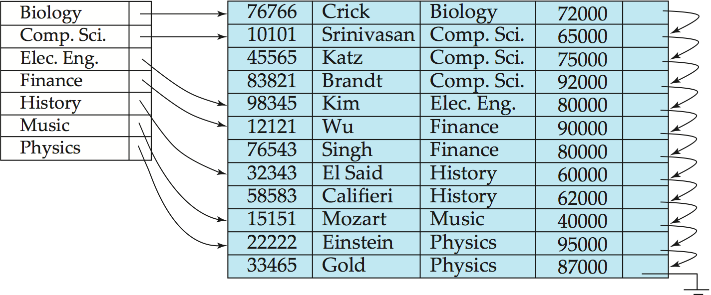
Primary Index ^{(REVIEW)}
Primary index: Index entries are sorted in the same way as the database records.

Slide 19
Secondary Index ^{(REVIEW)}
Secondary index: Index entries are sorted in a way different from the database records.
Re-directional pointers

Slide 20
Selection Operation
File scan
Algorithm A1 (linear search). Scan each consecutive file first block and test all records to see whether they satisfy the selection condition. b_{r} denotes number of blocks containing records from relation r
Worst case: cost = b_{r} block transfers + 1 seek = b_{r} * t_{T} + t_{S}
If selection is on a key attribute, can stop on finding record
cost = (b_{r} /2) block transfers + 1 seek= (b_{r} /2) * t_{T} + t_{S}
Linear search can be applied regardless of
selection condition or
ordering of records in the file, or
availability of indices

Slide 21
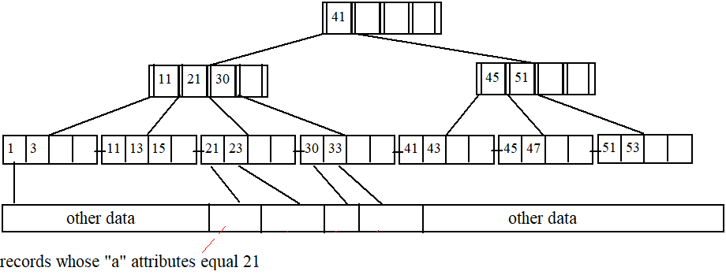
Selections Using Indices
Index scan – search algorithms that use an index
selection condition must be on search-key of index.
A2 (primary index, equality on key). Retrieve a single record that satisfies the corresponding equality condition
Select … from T where T.a = 21
Cost = (h_{i} + 1) * (t_{S} + t_{T})

Slide 22
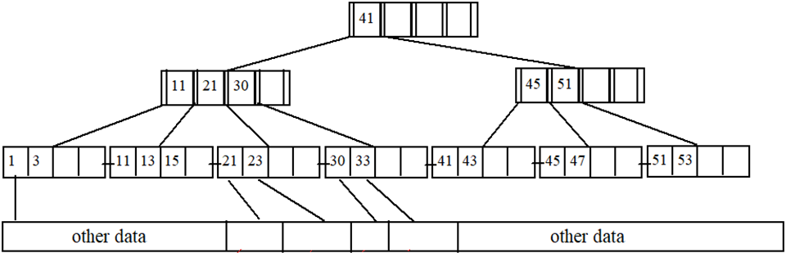
Selections Using Indices
A3 (primary index, equality on nonkey) Retrieve multiple records.
Records will be on consecutive blocks
Let b = number of blocks containing matching records
Cost = h_{i} * (t_{T} + t_{S}) + t_{S} + b*t_{T}
Select … from T where T.c = 21
b通常很大，被忽略

Slide 23
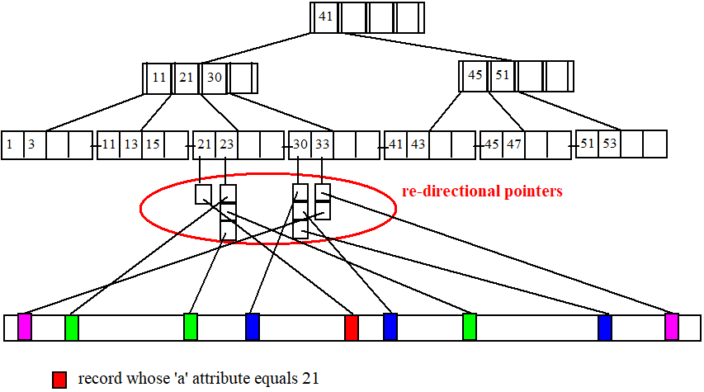
Selections Using Indices
A4 (secondary index, equality on key).
Retrieve a single record if the search-key is a candidate key
Cost = (h_{i} + 1) * (t_{T} + t_{S})
Select … from T where T.a = 21
Notes:
23

Slide 24
Selections Using Indices
A4 (secondary index, equality on nonkey).
Retrieve multiple records if search-key is not a candidate key
each of n matching records may be on a different block
Select … from T where T.a = 23
Cost = (h_{i} + n) * (t_{T} + t_{S})
Can be very expensive!
Notes:
24

Slide 25
Selections Involving Comparisons
Can implement selections of the form σ_{A≤V} (r) or σ_{A ≥ V}(r) by using
a linear file scan,
or by using indices in the following ways:
A5 (primary index, comparison). (Relation is sorted on A)
For σ_{A ≥ V}(r) use index to find first tuple ≥ v and scan relation sequentially from there
For σ_{A≤V} (r) just scan relation sequentially till first tuple > v; do not use index
Select … from T where T.a >= 21 and T.a <= 30
Cost = h_{i} * (t_{T} + t_{S}) + t_{S} + b*t_{T}
b通常很大，被忽略

Slide 26
Selections Involving Comparisons
A6 (secondary index, comparison).
For σ_{A ≥ V}(r) use index to find first index entry ≥ v and scan index sequentially from there, to find pointers to records.
For σ_{A≤V} (r) just scan leaf blocks of index finding pointers to records, till first entry > v
In either case, retrieve records that are pointed to
requires an I/O for each record
Linear file scan may be cheaper
Select … from T where T.a >= 21 and T.a <= 30
Cost = (h_{i} + n) * (t_{T} + t_{S})

Slide 27
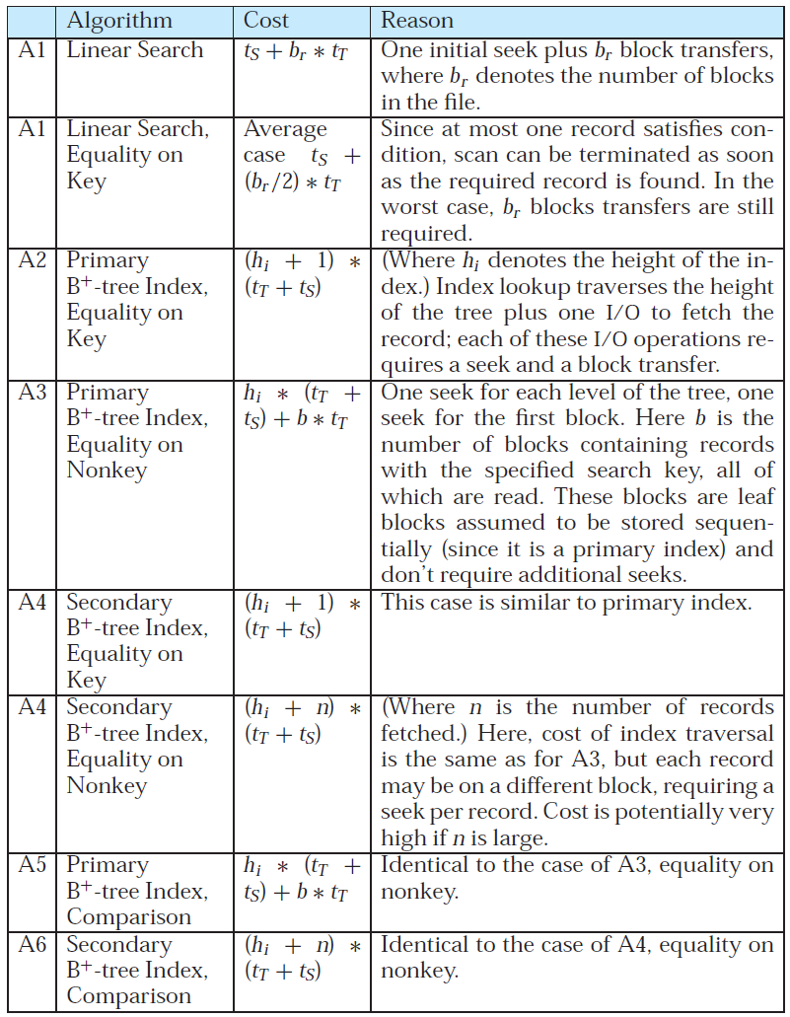
Cost estimates for selection algorithms

Slide 28
Implementation of Complex Selections
Conjunction: σ_{θ1}∧ _{θ2}∧. . . _{θn}(r)
A7 (conjunctive selection using one index).
Select a combination of θ_{i} and algorithms A1 through A7 that results in the least cost for σ_{θi} (r).
Test other conditions on tuple after fetching it into memory buffer.
A8 (conjunctive selection using composite index).
Use appropriate composite (multiple-key) index if available.
A9 (conjunctive selection by intersection of identifiers).
Requires indices with record pointers.
Use corresponding index for each condition, and take intersection of all the obtained sets of record pointers.
Then fetch records from file
If some conditions do not have appropriate indices, apply test in memory.

Slide 29
Select-多字段查询:A9
考虑以下查询：
Select … from T where T.a >= 21 and T.a <= 30 and T.b >= 21 and T.b <= 30.
Case 1: 字段 ‘a’和 ‘b’上都没有建立索引，则：
只能使用顺序扫描
Case 2:字段 ‘a’上有索引，而 ‘b’上没有索引，则：
找出那些满足 21 <= T.a and T.a <= 30的记录
去除那些不满足 21 <= T.b and T.b <= 30的记录
Cost ?
与a上的单字段查询代价一样，因为记录已经被读入内存
Case 3:字段 ‘b’上有索引，而 ‘a’上没有索引’
情况类似.

Slide 30
Select-多字段查询:A9
Case 4: 如果字段T.a和T.b上都建立了索引，那么执行计划又将不同
考虑以下查询：
Select … from T where T.a >= 21 and T.a <= 30 and T.b >= 21 and T.b <= 30.

Slide 31
Select-多字段查询:A9
First, using the B-tree on ‘a’, we retrieve the set S₁ of re-directional pointers of the leaf entries in [21, 30].
S₁

Slide 32
Select-多字段查询:A9
Then, from the B-tree on ‘b’, we retrieve the set S₂ of re-directional pointers of the leaf entries in [21, 30].
S₂

Slide 33
Select-多字段查询:A9
Compute S₁ ∩ S₂, which leads to a single disk address 7.
That is, only 1 tuple satisfies the query.
Visit block 7 to retrieve the tuple.
S₁∩S₂

Slide 34
Algorithms for Complex Selections
Disjunction:σ_{θ1}∨ _{θ2} ∨. . . _{θn} (r).
A10 (disjunctive selection by union of identifiers).
Applicable if all conditions have available indices.
Otherwise use linear scan.
Use corresponding index for each condition, and take union of all the obtained sets of record pointers.
Then fetch records from file
Negation: σ_{¬θ}(r)
Use linear scan on file
If very few records satisfy ¬θ, and an index is applicable to θ
Find satisfying records using index and fetch from file

Slide 35
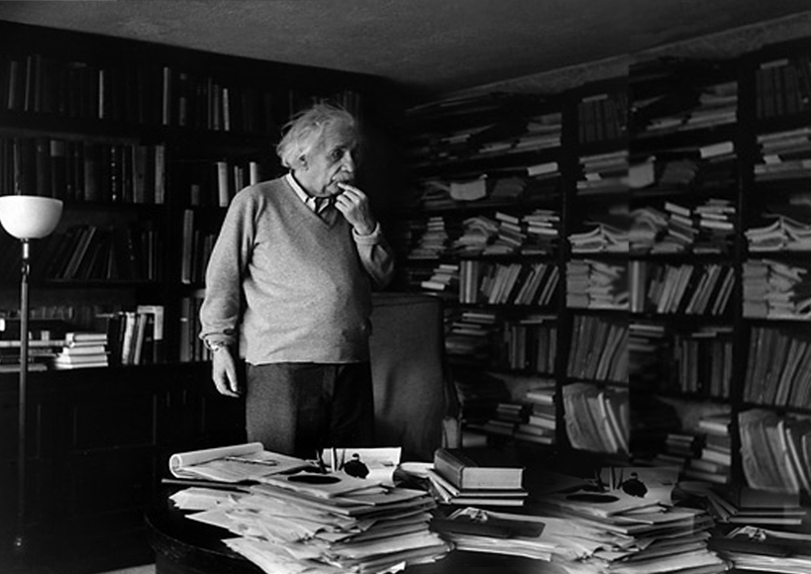
Sorting
Where is it ？
SORTING IS NEEDED IN LIFE.

Slide 36
Sorting
Sorting of data plays an important role in database systems
SQL queries can specify: order by, distinct, group by……
query processing (such as join) can be implemented efficiently if the input relations are first sorted.
We may build an index on the relation, and then use the index to read the relation in sorted order. May lead to one disk block access for each tuple.
For relations that fit in memory, techniques like quicksort can be used. For relations that don’t fit in memory, external sort-merge is a good choice.

Slide 37
外排序(例子一)
假设每个磁盘页可以容纳2个记录
内存最多可以放下3个磁盘页
目的：将以下记录按升序排列并要求I/O尽可能的小
外排序一般包含两个步骤：
Preliminary Sorting （预排序）
Merging （归并）

Slide 38
预排序(例子)
第一个有序归并段
I/O Cost = 6 block accesses
3 reads + 3 writes.

Slide 39
预排序(例子)
第二个有序归并段
I/O Cost = 6 block accesses
3 reads + 3 writes.

Slide 40
预排序(例子)
Do the same for every 3 subsequent blocks.
预排序结束后，一共得到4个有序归并段
总I/O代价 = 24 block accesses (12 reads + 12 writes). = twice the relation size.

Slide 41
1st 归并(例子)
该步骤的目标如下：

Slide 42
1st 归并(例子)
我们先来看看runs 0-1和runs 0-2是如何被归并为runs 1-1的.

Slide 43
归并两个有序归并段(例子)

Slide 44
归并两个有序归并段(例子)

Slide 45
归并两个有序归并段(例子)

Slide 46
归并两个有序归并段(例子)

Slide 47
归并两个有序归并段(例子)

Slide 48
归并两个有序归并段(例子)

Slide 49
归并两个有序归并段(例子)

Slide 50
1st 归并(代价)
再将runs 0-3和runs 0-4归并为runs 1-2.
1st 归并过程的I/O代价= 24 I/O accesses.
12 reads and 12 writes.（每页都是读一次，写一次）
该步骤完成之后，只剩下2个有序归并段runs 1-1和runs 1-2

Slide 51
2nd 归并过程(例子)
依照前面的排序方法，我们把runs 1-1和runs 1-2进行归并
Cost of the 2nd merging = 24 I/O accesses.
12 reads and 12 writes.
该步骤完成之后，只剩下1个有序归并段– 排序完成!

Slide 52
归并排序总I/O代价
Preliminary sorting step => 24 I/Os
1st merging step => 24 I/Os
2nd merging => 24 I/Os
Total 72 I/Os.

Slide 53
外排序例子二
Sort a file with 108 blocks, using only 5 memory blocks.
Total cost = 216 x 4 = 864 I/O accesses

Slide 54
External Sort-Merge (Cont.)
Sort a file with b_{r} blocks, using M memory blocks.
The preliminary sorting step produces n₀ = ⎡ b_{r} / M⎤ sorted runs by performing 2b_{r} I/Os.
The 1st merging step produces n₁ = ⎡n₀ / (M – 1)⎤ runs with 2b_{r} I/Os.
The 2nd merging step produces n₂ = ⎡n₁ / (M – 1)⎤ runs with 2b_{r} I/Os.
…
The last merging step produces n_{x} = ⎡n_{x-1} / (M – 1)⎤ = 1 run with 2b_{r} I/Os.

Slide 55
External Sort-Merge (Cont.)
Therefore the total cost =2b_{r} + 2b_{r} ⋅ x I/Os,
where x is the number of merging steps.
How to compute x?
Start with y = n₀
Do y = ⎡y / (M – 1)⎤ repetitively.
x is the number of repetitions before y becomes 1.
x = ⎡ log_{M-1}(b_{r} /M) ⎤

Slide 56
External Sort-Merge (Cont.)
Cost of transfers:
Total number of merge passes required: ⎡log_{M–1}(b_{r}/M)⎤.
Block transfers for initial run creation as well as in each pass is 2b_{r}
for final pass:
Output to screen: b_{r} ( 2 ⎡log_{M–1}(b_{r} / M)⎤ + 1)
Output to data file: b_{r} ( 2 ⎡log_{M–1}(b_{r} / M)⎤ + 2)
Seeks: next slide

Slide 57
External Sort-Merge (Cont.)
Cost of seeks
During sorted runs generation (1st phrase): one seek to read each run and one seek to write each run
2 ⎡b_{r} / M⎤
During the merge (2nd phase):
Buffer size: b_{b} (read/write b_{b} blocks at a time)
Need 2 ⎡b_{r} / b_{b}⎤ seeks for each merge pass
Total number of seeks:
Output to screen:2 ⎡b_{r} / M⎤ + ⎡b_{r} / b_{b}⎤ (2 ⎡log_{M–1}(b_{r} / M)⎤ -1)
Output to data file: 2 ⎡b_{r} / M⎤ +2 ⎡b_{r} / b_{b}⎤ ⎡log_{M–1}(b_{r} / M)⎤

Slide 58
Join Operation

Slide 59
Join Operation
Several different algorithms to implement joins
Nested-loop join
Block nested-loop join
Indexed nested-loop join
Merge-join
Hash-join
Choice based on cost estimate. We only consider the amount of transfers and ignore the amount of seeks because it is complex. Assume the result will be output to the screen.
Examples use the following information
Number of records of student: 5,000 takes: 10,000
Number of blocks of student: 100 takes: 400

Slide 60
Nested-Loop Join
To compute the theta join r _{θ} s -----------------------------------------------------------------
for each tuple t_{r} in r do begin for each tuple t_{s} in s do begin test pair (t_{r},t_{s}) to see if they satisfy the join condition θ if they do, add t_{r} • t_{s} to the result. end end
-----------------------------------------------------------------
r is called the outer relation and s the inner relation of the join.
Requires no indices and can be used with any kind of join condition.
Expensive since it examines every pair of tuples in the two relations.

Slide 61
Nested-Loop Join
特点：以元组（记录）为单位进行操作
关系大小：R -- n_{r} , b_{r}，S -- n_{s} , b_{s}

Slide 62
Nested-Loop Join (Cont.)
In the worst case, if there is enough memory only to hold one block of each relation, the estimated cost is n_{r} ∗ b_{s} + b_{r} block transfers
If the smaller relation fits entirely in memory, use that as the inner relation.
Reduces cost to b_{r} + b_{s} block transfers

Slide 63
Nested-Loop Join (Cont.)
Assuming worst case memory availability cost estimate is
with student as outer relation:
5000 ∗ 400 + 100 = 2,000,100 block transfers,
with takes as the outer relation
10000 ∗ 100 + 400 = 1,000,400 block transfers
If smaller relation (student) fits entirely in memory, the cost estimate will be 100+400=500 block transfers.
Block nested-loops algorithm (next slide) is preferable.

Slide 64
Block Nested-Loop Join
磁盘←→内存：以物理块（block）为信息传递的单位，面向block的连接称为块嵌套循环连接（BNL）
for each block B_{R} of R do begin for each block B_{S} of S do begin for each tuple t_{R} in B_{R} do begin for each tuple t_{S} in B_{S} do begin Check if (t_{R},t_{S}) satisfy the join condition if they do, add t_{R} • t_{S} to the result. end end end
end
ACCOUNT
CUSTOMER
name
account id
customer id
balance
customer id
1
John
A1
1
20k
Smith
A2
1
5k
2
A3
2
35k
3
Joan
A4
3
100k

Slide 65
Block Nested-Loop Join (Cont.)
In the worst case, if there is enough memory, only to hold one block of each relation, the estimated cost is：
b_{r} ∗ b_{s} + b_{r} block transfers
In the best case, if the smaller relation fits entirely in memory, use that as the inner relation, the estimated cost is:
b_{r} + b_{s} block transfers

Slide 66
Block Nested-Loop Join (Cont.)
Example before:
Number of records of student: 5,000 takes: 10,000
Number of blocks of student: 100 takes: 400
In the worst case：
100 ∗ 400+100 = 400100 block transfers
In the best case：
100 + 400 = 500 block transfers

Slide 67
Block Nested-Loop Join
R
S
Two tables R and S, with b_{r} and b_{s} blocks respectively.
Memory has M blocks.
How to compute the Cartesian product of R and S?
. . .
. . .
b_{r}
b_{s}
. . .
. . .
. . .

Slide 68
Block Nested-Loop Join
M-1 blocks
R
1 block
S
Without loss of generality, assume b_{r} < b_{s}.
Load M−1 blocks of the outer relation R at a time
Load 1 block of the inner relation S
perform one scan on S sequentially using this block
join it with all the M−1 blocks of R
. . .
. . .
. . .
b_{r}
b_{s}
. . .
. . .
. . .

Slide 69
Block Nested-Loop Join
R
1 block
S
Load the next M - 1 blocks of R into memory.
Perform one scan on S.
…
Until all blocks in R are loaded once.
I/O Cost?
⎡b_{r} /(M− 1)⎤ ∗ b_{s} + b_{r} blocks
. . .
M-1 blocks
. . .
. . .
b_{r}
b_{s}
. . .
M-1 blocks
. . .
. . .
. . .

Slide 70
Block Nested-Loop Join (Cont.)
嵌套循环与块嵌套循环算法的性能可以改进:
增大可用内存，使得较小的表完全放下内存，此时传输代价最小(b_{r} + b_{s})
如果连接属性是内层关系的码，则内层循环一旦找到首条匹配元组就可以终止
对内层循环轮流做向前、向后的扫描 (with LRU replacement)，重用上一次扫描时留在缓冲区的数据块，从而减少磁盘存取
如果可以， 使用内表上的索引(next slide)

Slide 71
Indexed Nested-Loop Join
Index lookups can replace file scans if
join is an equi-join or natural join and
an index is available on the inner relation’s join attribute
Can construct an index just to compute a join.
For each tuple t_{r} in the outer relation r, use the index to look up tuples in s that satisfy the join condition with tuple t_{r}.
t_{r.}a
r
selection on S by index, t_{s.}a = t_{r.}a
s
s

Slide 72
Indexed Nested-Loop Join
Worst case: buffer has space for only one block of r, and, for each tuple in r, we perform an index lookup on s.
Cost of the join: b_{r} + n_{r} ∗ c
Where c is the cost of traversing index and fetching all matching s tuples for one tuple or r
c can be estimated as cost of a single selection on s using the join condition.
If indices are available on join attributes of both r and s, use the relation with fewer tuples as the outer relation.

Slide 73
Example of Nested-Loop Join Costs
Compute student takes, with student as the outer relation.
Let takes have a primary B⁺-tree index on the attribute ID, which contains 20 entries in each index node.
Since takes has 10,000 tuples, the height of the tree is 4, and one more access is needed to find the actual data, student has 5000 tuples
Cost of block nested loops join?
400*100 + 100 = 40,100 block transfers
assuming worst case memory, may be significantly less with more memory
Cost of indexed nested loops join?
100 + 5000 * 5 = 25,100 block transfers.

Slide 74
Merge-Join
Sort both relations on their join attribute (if not already sorted on the join attributes).
Merge the sorted relations to join them
Join step is similar to the merge stage of the sort-merge algorithm.
Main difference is handling of duplicate values in join attribute — every pair with same value on join attribute must be matched
Detailed algorithm in book

Slide 75
Join-排序-归并连接(sort-merge join)
T1(a, b) and T2(a, c).
select * from T1, T2 where T1.a = T2.a
Two steps:
Sort T1 by column ‘a’, and T2, too.
External sort.
Merge the sorted T1 and T2.
In a way similar to the “merging step” in external sort.
An example on the next slide.

Slide 76
Join-排序-归并连接(例子)
简单起见，这里只显示T1和T2中属性a上的取值

Slide 77
Join-排序-归并连接(例子)

Slide 78
Join-排序-归并连接(例子)

Slide 79
Join-排序-归并连接(例子)

Slide 80
Merge-Join (Cont.)
Can be used only for equi-joins and natural joins
Each block needs to be read only once (assuming all tuples for any given value of the join attributes fit in memory
Thus the cost of merge join is:
b_{r} + b_{s} block transfers, plus the cost of sorting if relations are unsorted.
hybrid merge-join: If one relation is sorted, and the other has a secondary B⁺-tree index on the join attribute
Merge the sorted relation with the leaf entries of the B⁺-tree .
Sort the result on the addresses of the unsorted relation’s tuples
Scan the unsorted relation in physical address order and merge with previous result, to replace addresses by the actual tuples
Sequential scan more efficient than random lookup

Slide 81
Hash-Join
Applicable for equi-joins and natural joins.
A hash function h is used to partition tuples of both relations
h maps JoinAttrs values to {0, 1, ..., n}, where JoinAttrs denotes the common attributes of r and s used in the natural join.
r₀, r₁, . . ., r_{n} denote partitions of r tuples
Each tuple t_{r} ∈ r is put in partition r_{i} where i = h(t_{r} [JoinAttrs]).
r₀,, r₁. . ., r_{n} denotes partitions of s tuples
Each tuple t_{s} ∈s is put in partition s_{i}, where i = h(t_{s} [JoinAttrs]).
Note: In book, r_{i} is denoted as H_{ri,} s_{i} is denoted as H_{si} and n is denoted as n_{h.}

Slide 82
Hash-Join (Cont.)

Slide 83
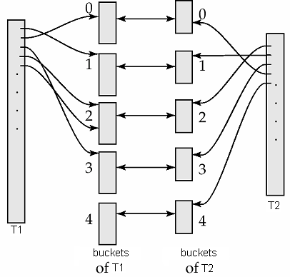
Join-散列连接(hash join)
Create a hash index on the ‘a’-column of T₁ and T₂, respectively, using the same hash function.
Join bucket 0 of T₁ and T₂
…
Join bucket 4 of T₁ and T₂
Do we need to join bucket 1 of T₁ with bucket 2 of T₂?
NO. No join results can be produced from these two buckets.
SELECT * FROM T₁, T₂ WHERE T₁.a = T₂.a

Slide 84
合并两个桶
We distinguish 2 cases depending on whether the smaller relation fits in memory.

Slide 85
合并两个桶(cont.)
Assume that the memory has M blocks.
Case 1: The smaller bucket has no more than M – 1 blocks.
See the right example.
We apply BNL on the two buckets.
Load the entire bucket of T₂ into memory.
Scan the bucket of T₁ once to produce join results.

Slide 86
合并两个桶(cont.)
Assume that the memory has M blocks.
Case 2: The smaller bucket has at least M blocks.
Recursively apply hash join.
Hash the data in both buckets into sub-buckets using a different hash function.
Join the corresponding sub-buckets.

Slide 87
Join-散列连接(例子)
T₁ has 45 blocks and T₂ has 450 blocks. Our memory has 6 blocks.
Hash each table into 5 buckets.
Total Cost with BNL?
45+45*450/5=4095

Slide 88
Cost = (45 + 450) x 2 = 990 I/Os
Hashing reads and writes a relation once.

Slide 89
Join bucket 0 of T1 and T2. Both buckets have more than 5 blocks => re-hashing.

Slide 90
Cost = (25 + 250) x 2 = 550 I/Os. Data in the two buckets is read and written once.

Slide 91
Join “sub-bucket 0” of T1 and T2. Both buckets have more than 5 blocks => re-hashing.

Slide 92
Hash sub-bucket 0 again. Cost = (6 + 60) x 2 = 132 I/Os.

Slide 93
Join sub-sub-bucket 0 of T1 and T2. Cost = 22 I/Os.

Slide 94
Join sub-sub-bucket 1 of T1 and T2. Cost = 11 I/Os.
Similarly, for sub-sub-buckets 2, 3, 4…

Slide 95
Join sub-bucket 1 of T1 and T2. Cost = 55 I/Os.
Similarly, for sub-buckets 2, 3, 4…

Slide 96
Join bucket 1 of T1 and T2. Cost = 55 I/Os.
Similarly, for buckets 2, 3, 4…

Slide 97
Total cost = 990 + 550 + 132 + 22 + 11 + 11 + 11 + 11 + 55 + 44 + 55 + 55 + 55 + 55 + 55 + 55 = 2167 I/Os < 4095 I/Os

Slide 98
Evaluation of Expressions
So far: we have seen algorithms for individual operations
Alternatives for evaluating an entire expression tree
Materialization: generate results of an expression whose inputs are relations or are already computed, materialize (store) it on disk. Repeat.
Pipelining: pass on tuples to parent operations even as an operation is being executed
We study above alternatives in more detail

Slide 99
Materialization
Materialized evaluation: evaluate one operation at a time, starting at the lowest-level. Use intermediate results materialized into temporary relations to evaluate next-level operations.
E.g., in figure below, compute and store then compute the store its join with instructor, and finally compute the projection on name.

Slide 100
Materialization (Cont.)
Materialized evaluation is always applicable
保留中间结果导致的读写磁盘次数较多
Overall cost = Sum of costs of individual operations + cost of writing intermediate results to disk
双缓冲: 一个用于连续执行算法、另一个用于写出结果
允许CPU与I/O活动并行，从而提高算法效率
为输出缓冲区分配额外的磁盘块，使得每次可以同时写多个块，减少磁盘搜索次数

Slide 101
Pipelining
Pipelined evaluation: 同时执行几个操作，将得到的结果立即传送给下一个操作
E.g., in previous expression tree, don’t store result of
instead, pass tuples directly to the join.. Similarly, don’t store result of join, pass tuples directly to projection.
优点：
消除读写中间结果的代价，提高查询性能
一旦有输入，合并为流水线的操作可以迅速产生结果，减少用户等待时间
缺点：对于排序、哈希连接来说并不适用.

Slide 102
Pipelining (两种执行方式)
需求驱动的流水线(pull model)
系统不停的向顶层操作发出需要元组的请求
在请求之间，操作要记录元组的状态并判断如何获得下一组元组
生产者驱动的流水线(push model)
操作积极的产生元组并传递给上层操作
子操作把结果放入缓冲区，父操作取出结果
如果缓冲区满了，则子操作等待父操作取出元组
系统调度不同的操作，使得输出缓冲区尽量有足够的空间来处理更多的元组

Slide 103
Assignments
12.2
12.3 a、b、c（只计算传输块数）
选作：12.10

Slide 104
End of Chapter

